Slide 1

Research: Why & How!! MSP Meetup: Nashik
BY :- Vedant Bahel

Slide 2
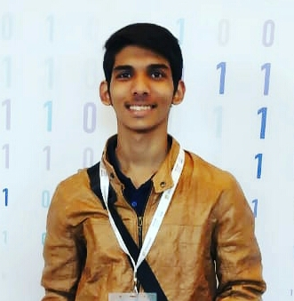


Hey, Vedant here!
Second year student in B.TECH in IT from GHRCE, Nagpur
Microsoft Student Partner
Researcher (Data Science & Machine Learning)
Founder, Data Deals
Co-founder Medilysis
@vedant_bahel
@Vedant_Bahel

Slide 3
What is Research?
Creativity to enhance knowledge
Heart of every discipline of science
Can be done on any topic
Innovation
Problem Solving
Analysis
Observation

Slide 4
How to get started?
Start by Own
Find an Research Internship
Well, We Recommend you both.

Slide 5
How to Write a Research Paper?
Step 1: Confined your Research Area. Most of you have fixed research areas. But some of you may be confused. In that case take any on which fascinates you. You shall try Hit & Trial method.
Step 2: Once you have fixed your area. Look for recent papers in the area. Look for existing papers. You can find papers on Google Scholar (https://scholar.google.com/).
Step 3: Try deciding your own research title.
Note: A Particular research paper can be: Review, Research and Case Study as well.

Slide 6
General Format for the Paper
Title
Abstract
Introduction
Literature Review
Methodology / Proposed Project
Result & Discussion
Conclusion
References

Slide 7
Finally getting it published
Look for some relevant Conference & Journal
Put it into the format
Submit the paper
Wait for your acceptance
Congrats! You are a #Researcher

Slide 8
FAQs
Which Conferences to choose? Only go for reputed conferences by IEEE, Springer, Elsevier, etc.
Which Journals to choose? UGC Approved or SCI or Scoups Indexed Journals.
Do we have to pay to get paper published? Yes, most of the time.
How to avail funding/travel grant for the Conference? There are many agencies which supports student researcher to publish their paper by sponsoring the registration fee and travel reimbursement.

Slide 9
Going for an Research Internship

Slide 10
Why Research Internship?
Experience a professional working environment
Build and practice new skills
In-depth knowledge of technologies
Get a perspective on the current on-going research and helps you decide if you wish to pursue higher studies or work.
Letter of recommendations
Writing and publishing of research papers
Boost your resume while applying for masters or for any research-based job

Slide 11


Some Research Internship Programs
Celestini Program India - IIT Delhi
Precog Research group - IIIT Delhi
IIIT Delhi Research internships
Apply under any professor through emailing them

Slide 12




Celestini Project India
https://www.celestiniprojectindia.com/
Sponsored by Google and Marconi Society
Mentors from Google Brain
Applications opens in March
Team size 2 to 4
Two themes - Air Pollution and Women Safety

Slide 13
Procedure:
Round 1: 5 sections consisting of two ML sections, One Quiz section, One design question based on the solution of any one given theme and one probability section. Time allotted 36hrs.
Round 2: Telephonic interview of selected teams
Round 3: Final Selection List.
Tech Stack:
Mainly - Machine Learning and Analytics
Related to your proposed idea

Slide 14
Perks
Training Letter
Certificate
Stipend of $200 to each team member
Winning team gets a stipend of $1500

Slide 15
General Application Requirement
Cover Letters
Resume
Statement of Purpose
Ability to read journals and research papers
Completion of Task provided by professors

Slide 16
Summarising
Not so difficult
Find your interest
Look out for the programs matching your interests
Look out for the professors of different Universities matching your interest
Then simply apply
Don’t fear for rejections

Slide 17


Slide 18
Thank you

